Slide 1


Final Project
IMPACT OF COVID-19 ON ABC COMPANY’S PARCEL DELIVERY BUSINESS
Sub: Programming for Data Science

Slide 2

PROJECT MEMBERS
TIRTH PATEL
PRIYANK PATEL
NEEL PATEL
NACHIKET PRAJAPATI

Slide 3

INTRODUCTION
The COVID-19 pandemic has affected businesses in Canada differently. Some have thrived due to increased online shopping, while others have struggled. ABC Company, operating in parcel delivery, serves clients from various sectors, each facing unique challenges during the pandemic.
In this presentation, we'll explore how COVID-19 has impacted ABC Company's parcel delivery business, helping us understand the changes and make informed decisions.

Slide 4
ANALYSIS OF MAIN BUSINESS QUESTIONS:
How did the COVID-19 pandemic impact ABC Company’s parcel business?

Slide 5
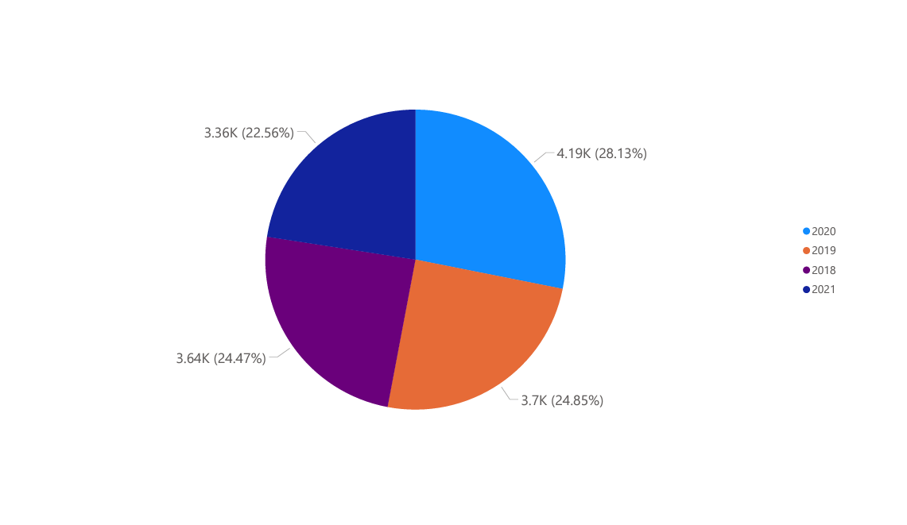
IMPACT OF THE SHIPMENTS VOLUME:
In 2020, there was a noticeable change in the pattern of parcel shipments, with a substantial increase in shipment volumes during certain periods of the year. This surge in parcel shipments aligns closely with the timing of lockdowns and restrictions imposed due to the pandemic, indicating a surge in demand for parcel delivery services as consumers turned to online shopping and remote work arrangements.

Slide 6
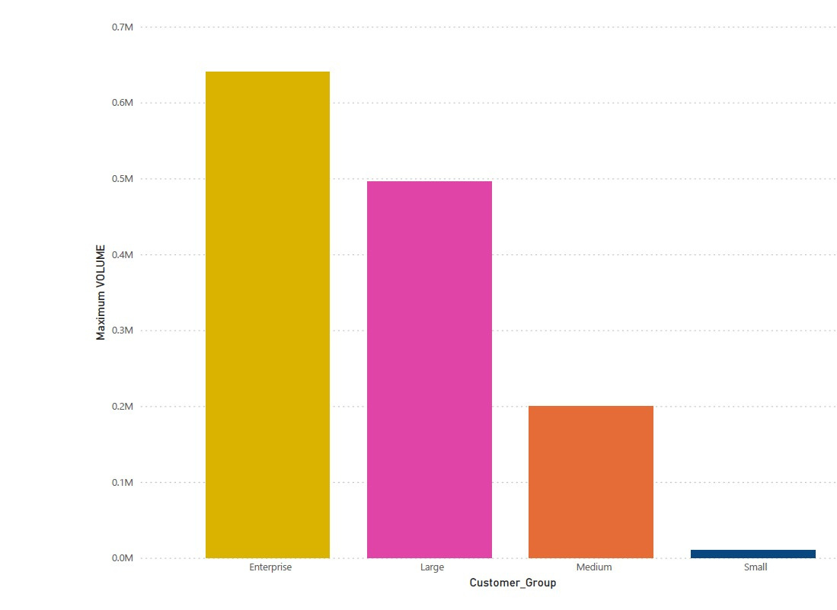
IMPACT OF COVID-19 ON PEAK SEASON IN 2020
we've extracted data for the peak season, defined as Week 45 of 2020 to Week 2 of 2021.
The total parcel volume during this peak season was calculated. Additionally, we compared this volume to the same period in 2019 to gauge the impact.
The results are in. The total parcel volume during the COVID-19 peak season was significantly changed.
This insight sheds light on how COVID-19 affected our operations during the busiest time of the year.

Slide 7
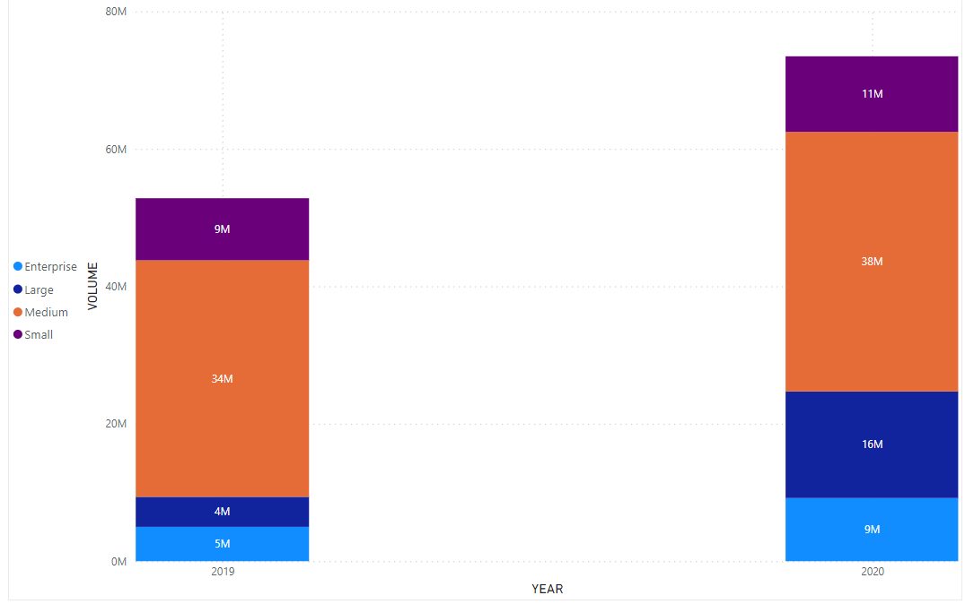
OVERALL IMPACT OF COVID-19 ON VOLUME BY CUSTOMER GROUP BETWEEN 2019 AND 2020.
We've meticulously analyzed data spanning the pre-COVID period of 2019 and the COVID observation period of 2020.
We've calculated the total parcel volumes for each customer group in both periods, allowing us to discern changes over time.
As you can see, the bar chart illustrates the change in parcel volumes by customer group from the pre-COVID to the COVID observation period.

Slide 8


CONCLUSION
In conclusion, our research has shown important changes in parcel shipment trends for 2020, which are directly linked to lockdowns and other measures related to the pandemic. The increase in package volumes from the week 45, 2020, to Week 2, 2021, the peak season, highlights the critical role our organization plays in providing basic services in emergency situations.
When we contrasted parcel volumes in 2019 and 2020, we saw significant shifts for various customer segments, which is indicative of how the market demands changed during the pandemic.
We can better adjust our strategies and improve our services to match changing customer needs by utilizing these insights.

Slide 9

THANK YOU FOR YOUR ATTENTION

